Slide 1

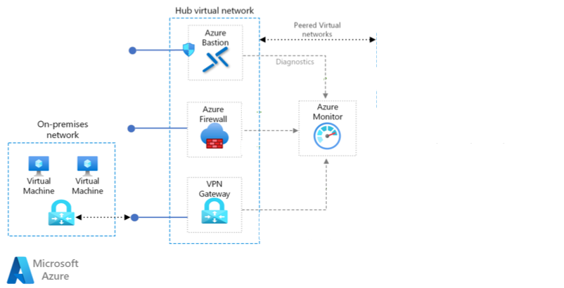






Preferred Solution Diagram
Hub Virtual Network
Spoke Virtual Network
Existing
On-Premises Network
Subnet: Front-end Web Application
Subnet: Azure Database for MySQL
Azure ExpressRoute

Slide 2




